Slide 1
Bay State Banner:
Voting Patterns
Group members:
Abdullah Albijadi, Audrey McMillion, Gordon Ng,
Ji Zhang, Thachathum Amornkasemwong

Slide 2


Project Overview:
In this project, we are trying to understand how racial voting patterns in Boston changed over the past decade on the Ward Precinct level. The components to measure voting behavior include ballots cast, blanks cast, registration, eligible voters, and turnout along with census data.
Key questions include:
How do racial voting patterns differ by election type?
What are the key predictors in determining support for Black candidates for Boston?

Slide 3


Step:
1
Search & Clean Data

Slide 4

Given Datas:
2019 Mayoral Races
(Prelim and General)
2011, 2013, 2015, and 2017, 2019 City Council Races
2019 DA Race
Pulled Datas:
2016, 2020 Presidential Races
2018 U.S. House Primary (Democratic)
2020 U.S. House Primary (Democratic)

Slide 5
Step:
2
Deliverable 1

Slide 6

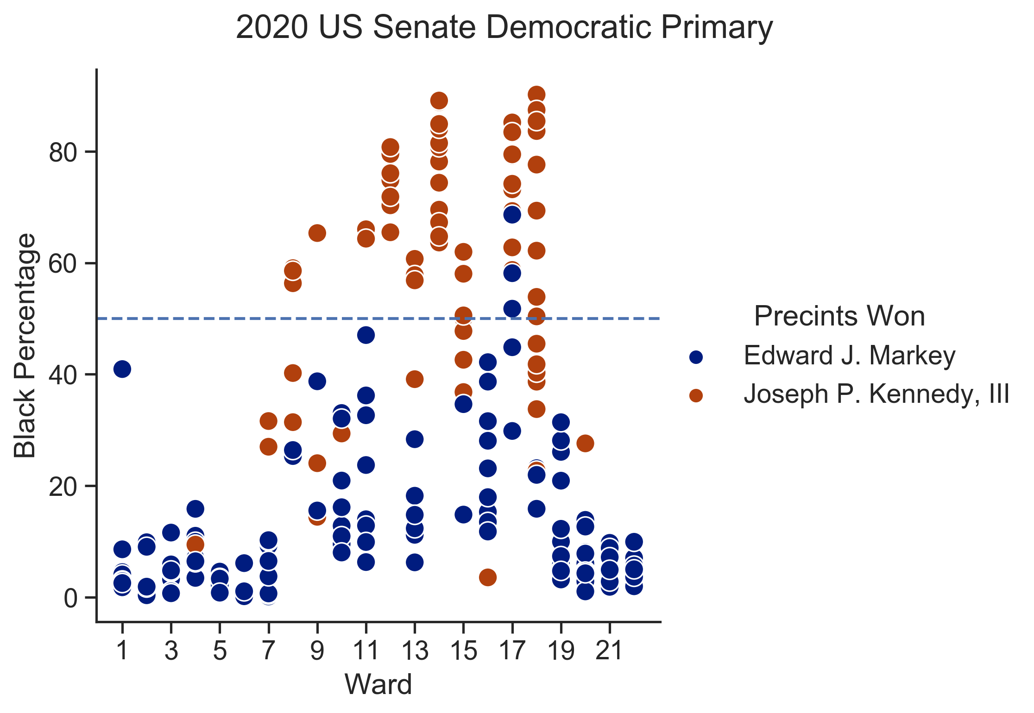
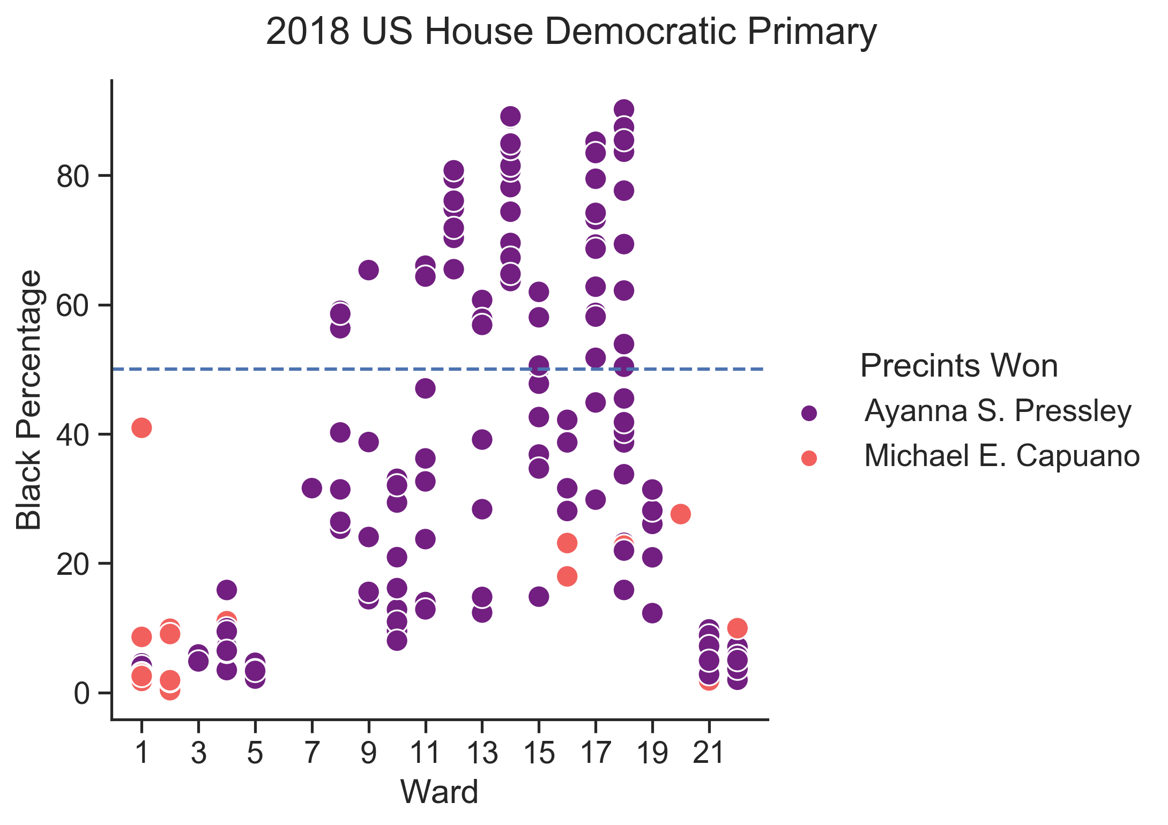
Is there any racial relation at all with election results?

Slide 7

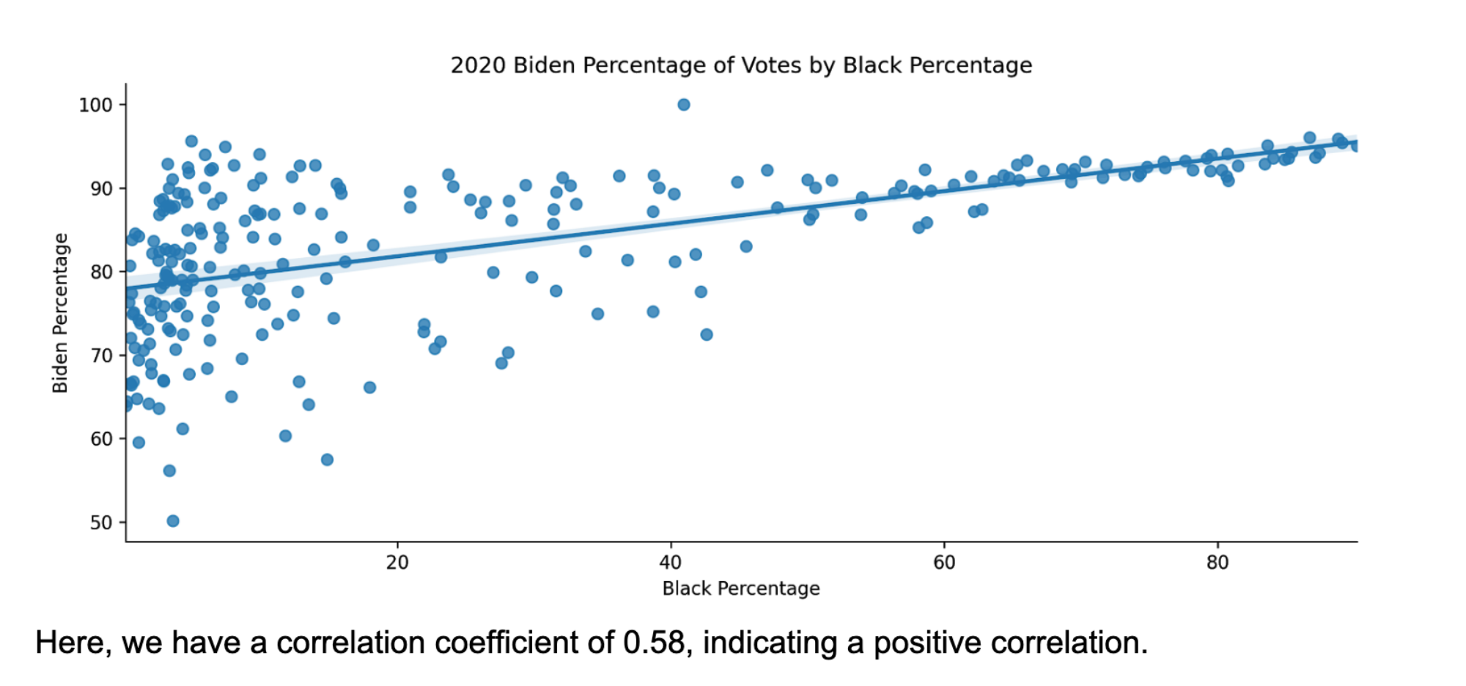
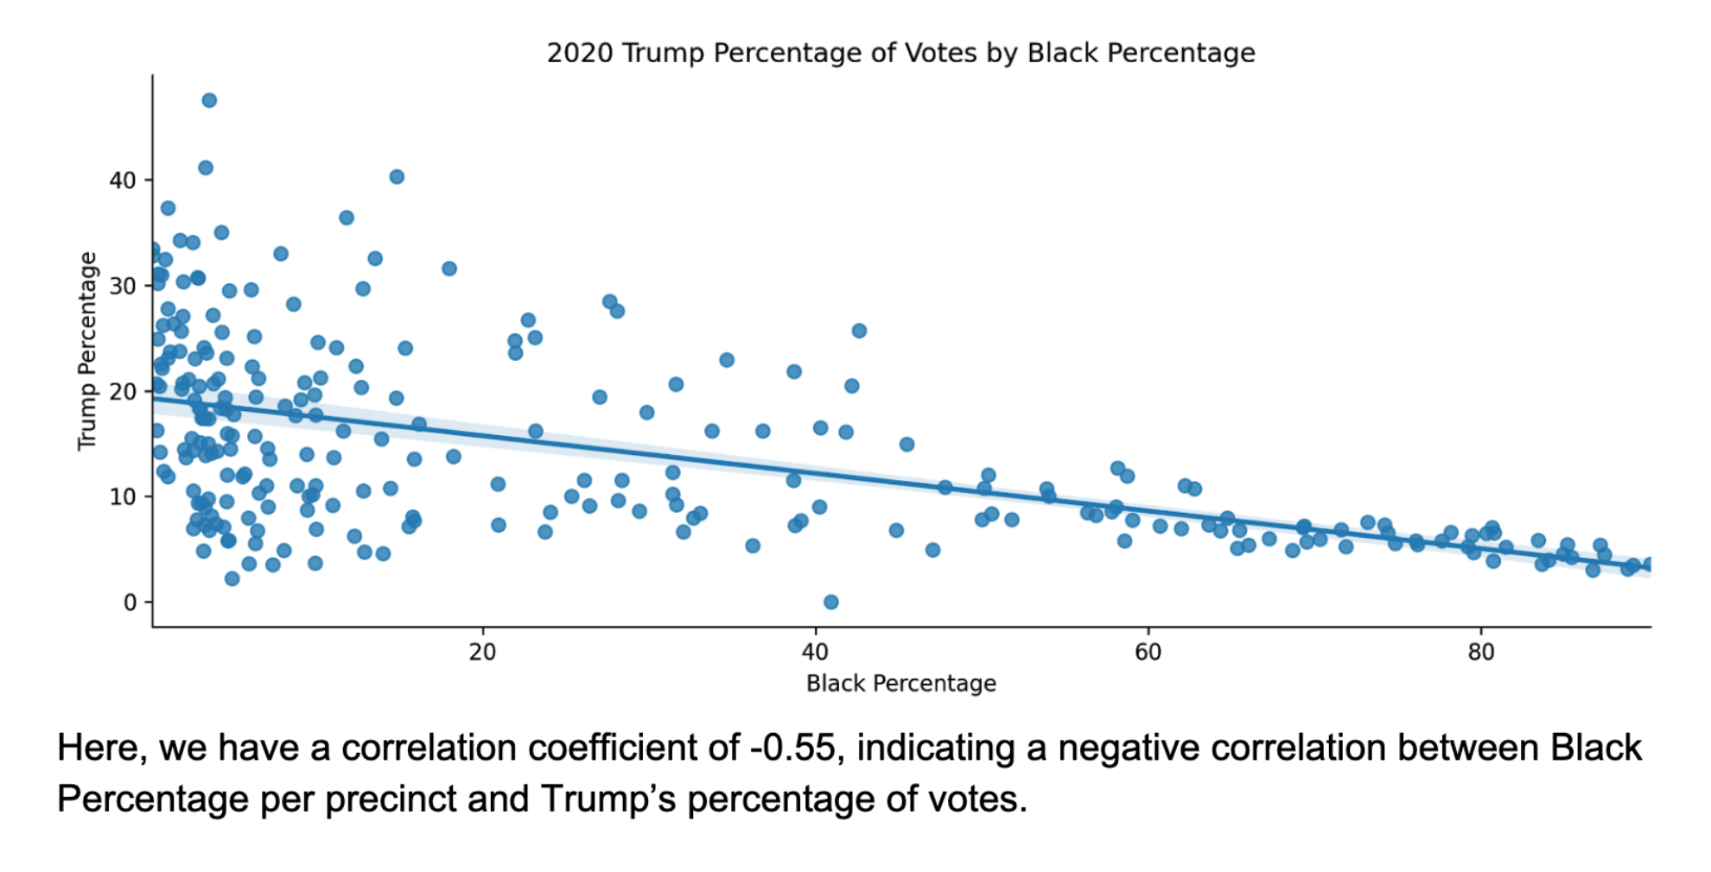
Regression Analysis of 2020 Presidential Election
Conclusion: Districts with high Black populations tend to vote similarly.

Slide 8
Step:
3
Deliverable 2

Slide 9
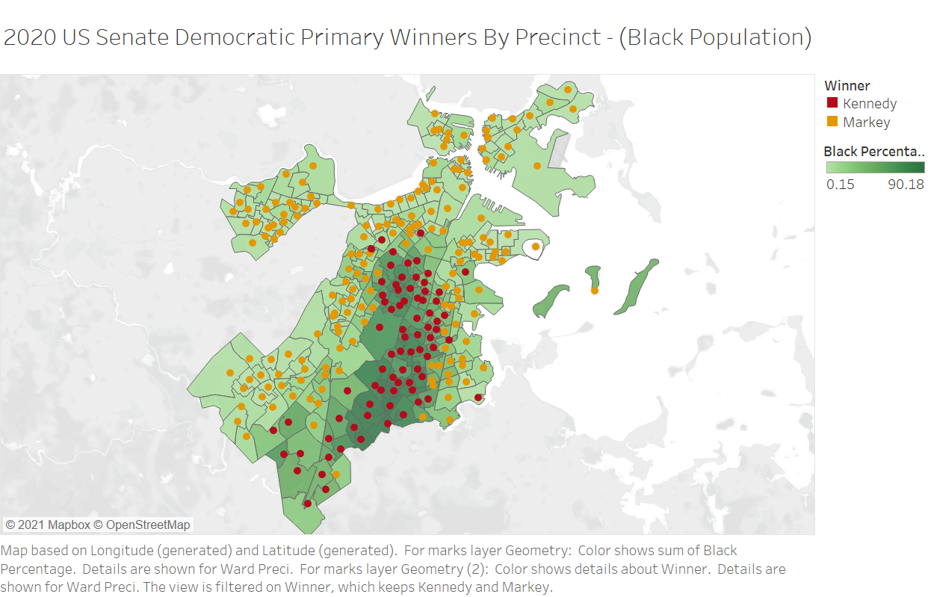
Data Visualization Examples

Slide 10
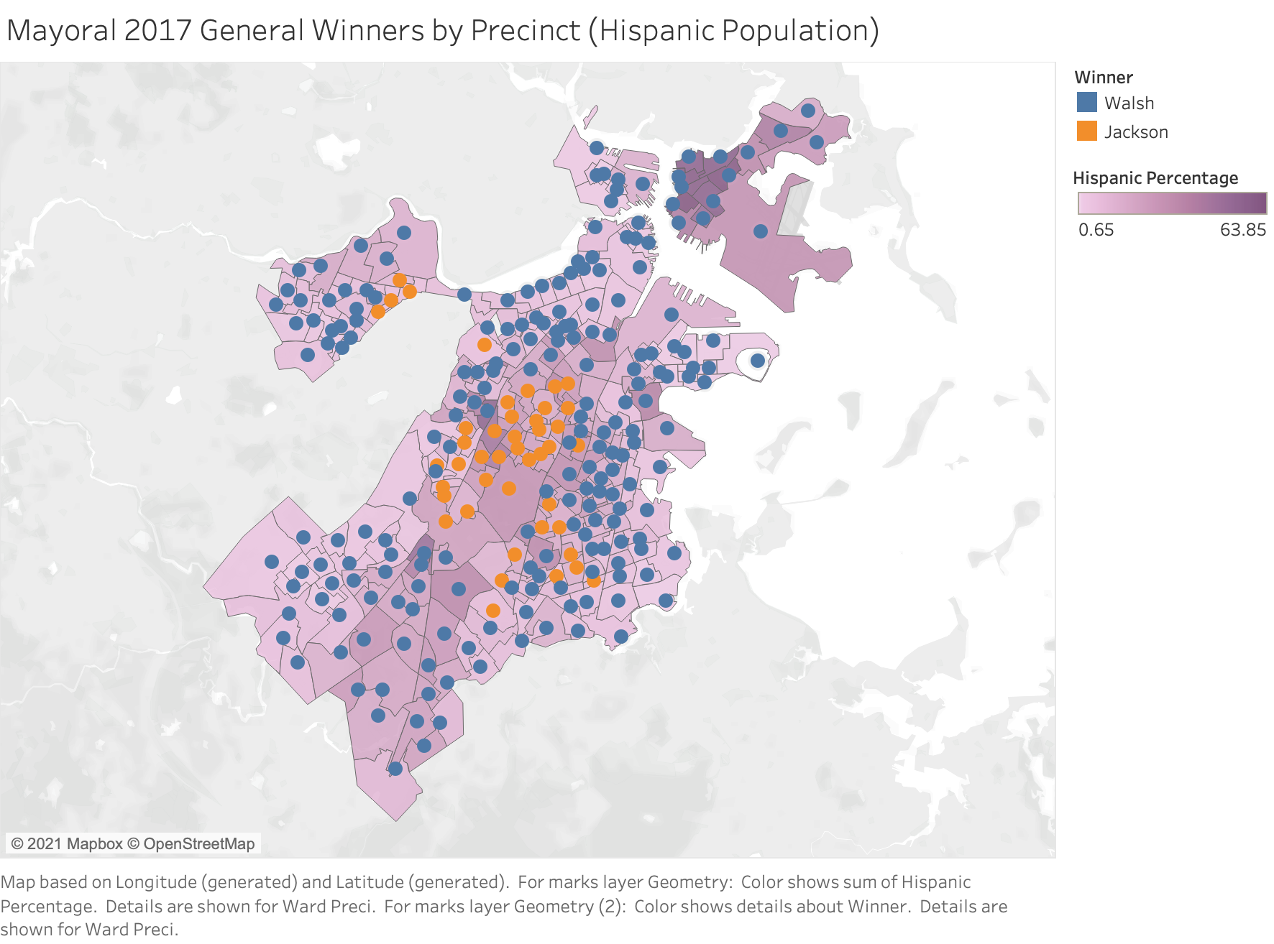

Slide 11
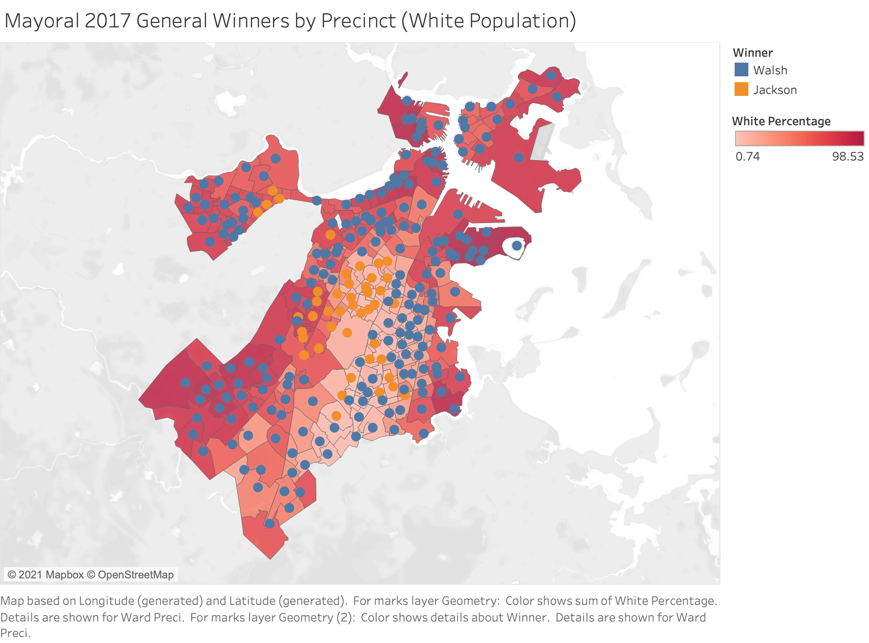

Slide 12
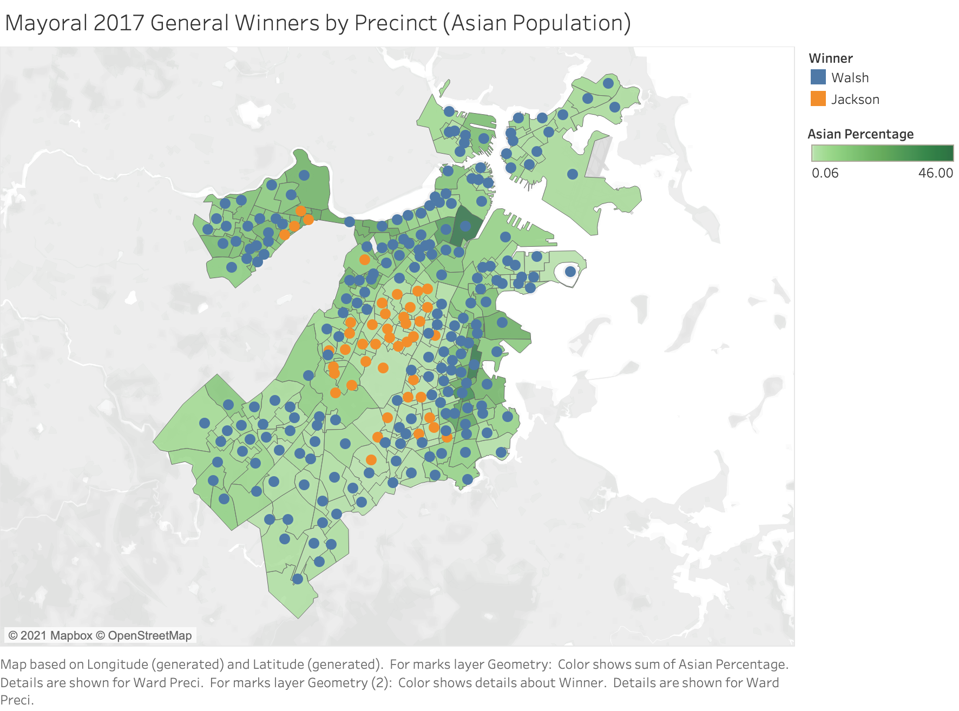

Slide 13
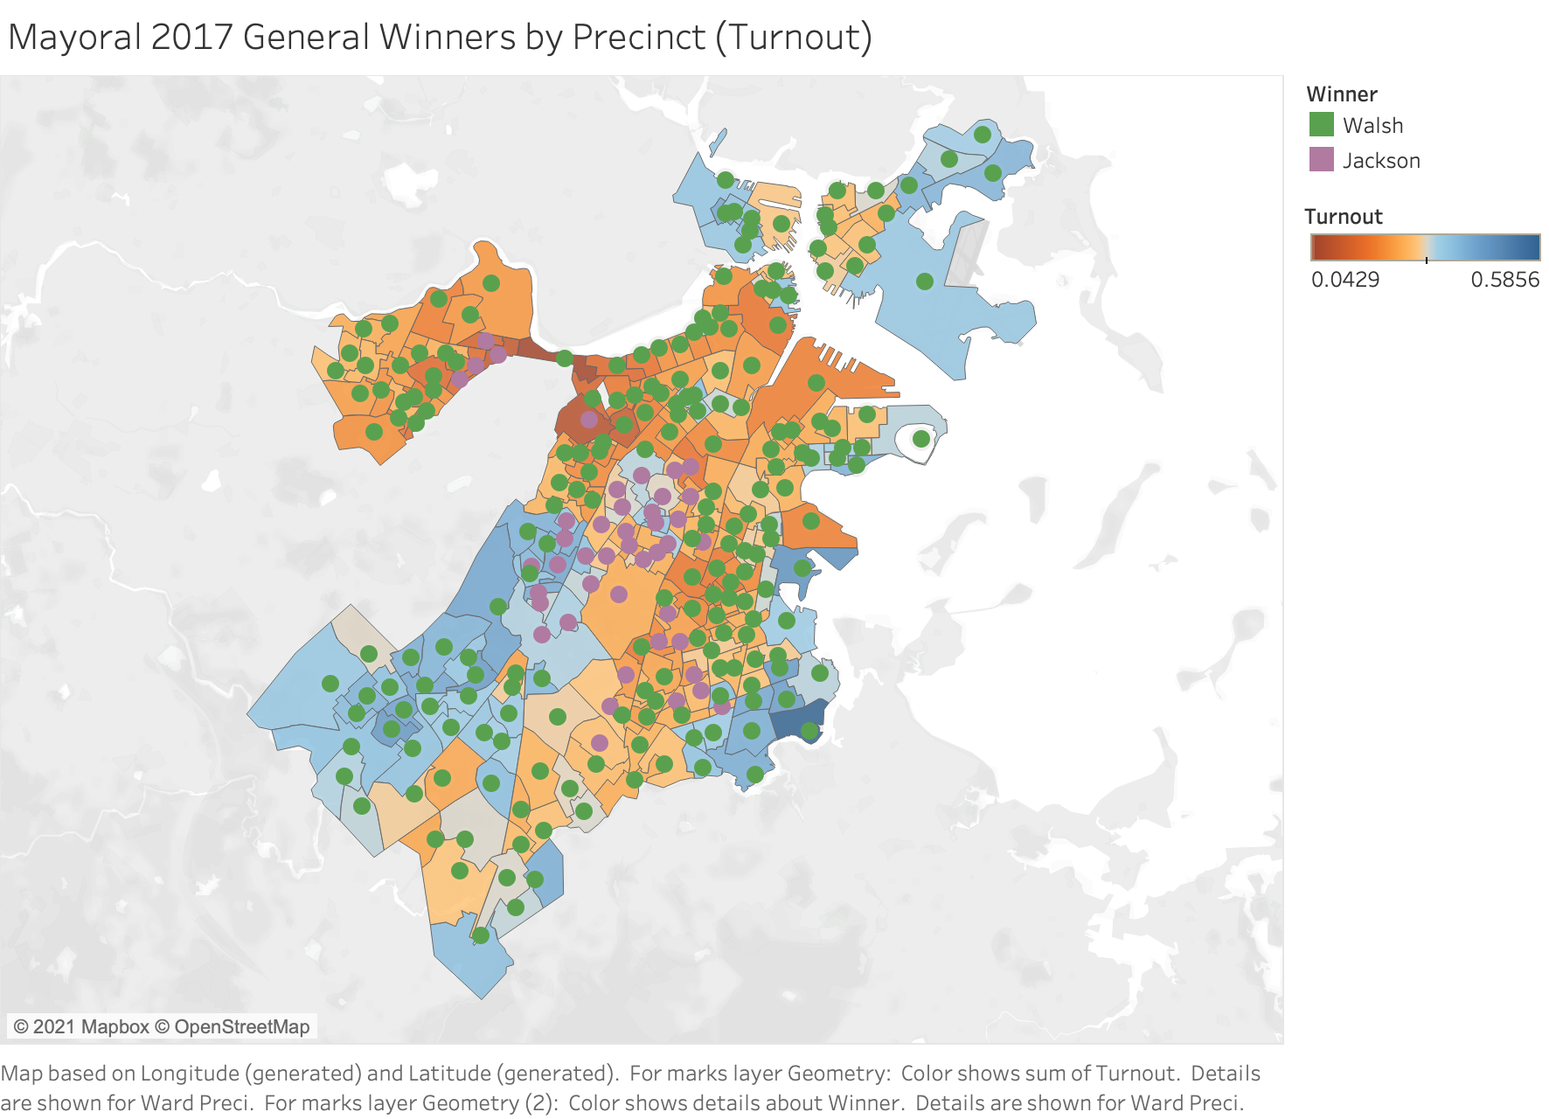

Slide 14
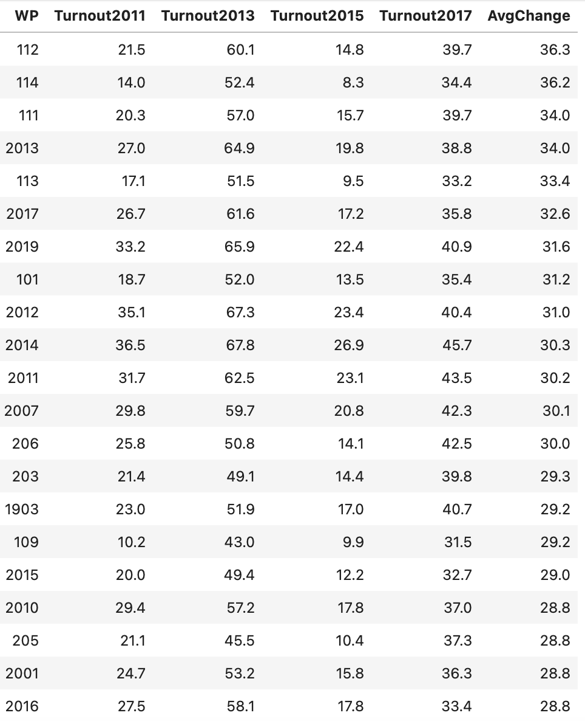
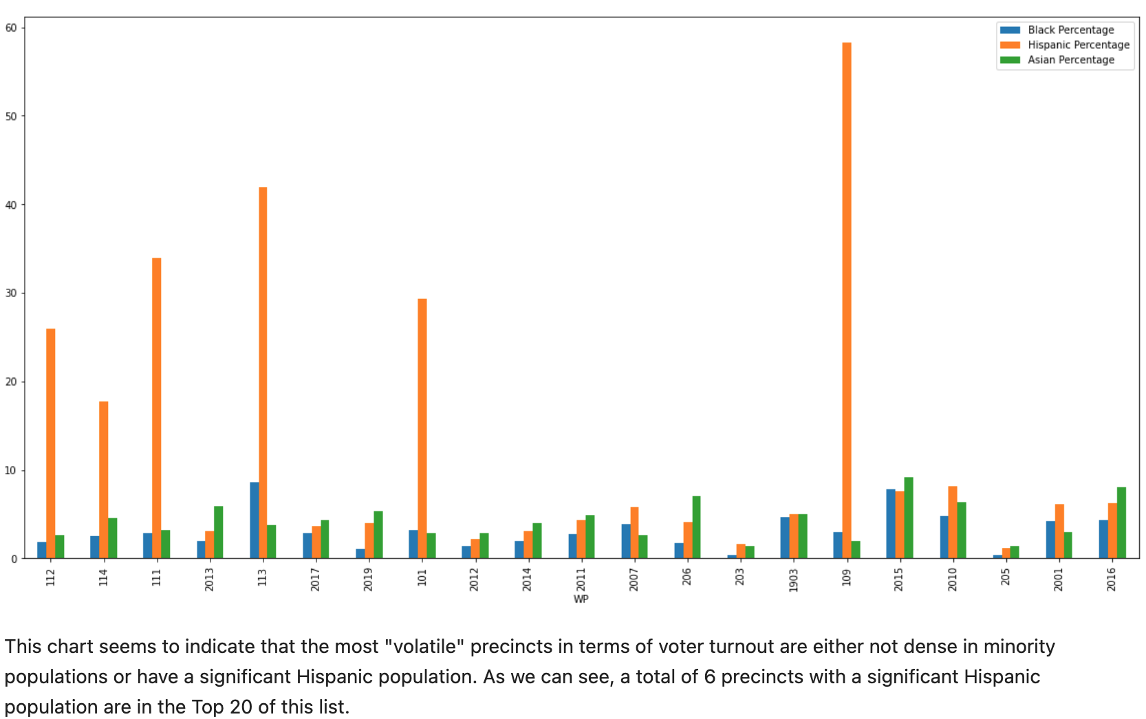
How has voter turnout by precinct changed across election year from 2011-2019?
Top 20 Precincts with greatest average change in voter turnout:
Notes:
Need to fix these slides with updated data

Slide 15
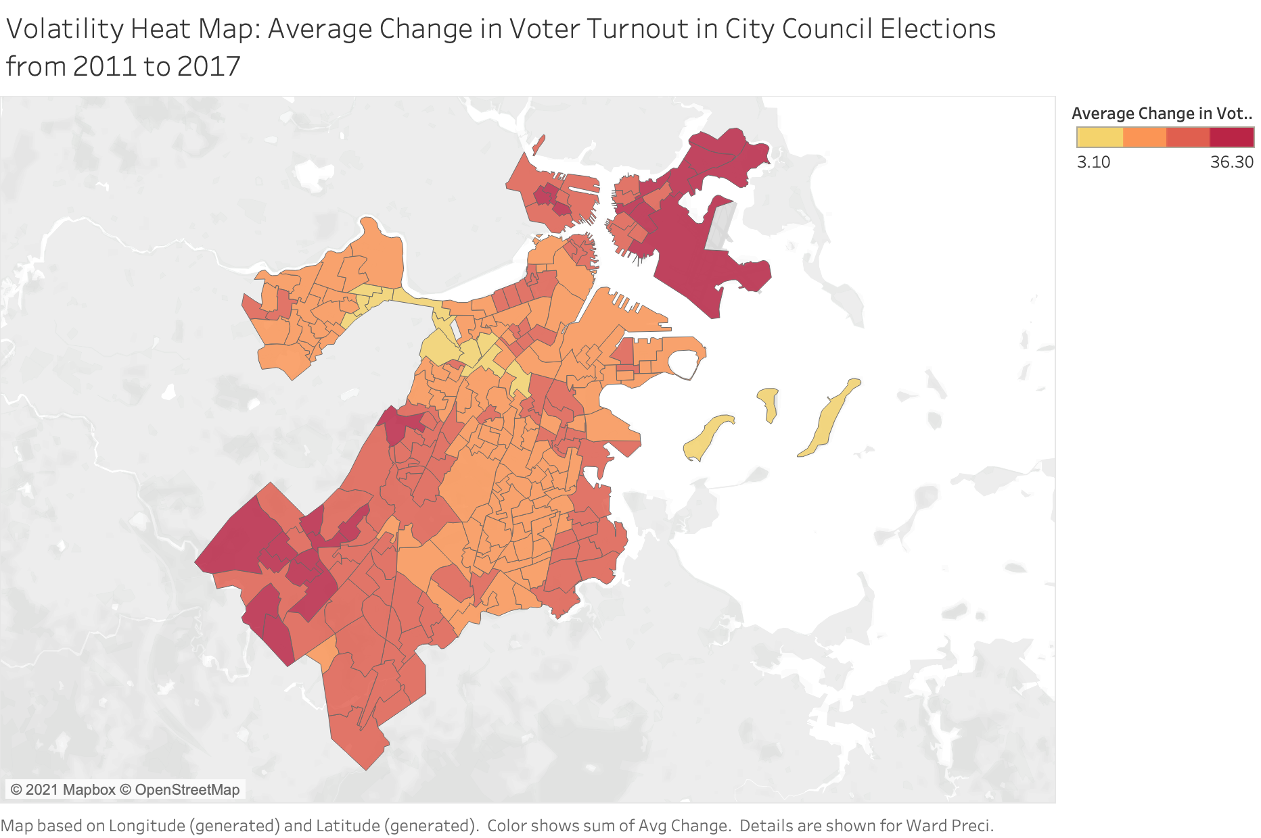
Districts Easy to be Swayed for City Council Election?

Slide 16

Step:
4
Future Plan

Slide 17
Deliverable 3 & 4 Plan
Expand on more analysis across different years
Add/join more informative datasets (income/housing data)
Answers more questions:
How have the demographic changes affected the prospects for candidates of color and white candidates?
Pattern changes in specific districts
Main challenges:
Incomplete data
Outdated census data

Slide 18
THANKS

